Slide 1


Variation in Tropical Tree Response to Increased Atmospheric Carbon
Dan Petticord

Slide 2

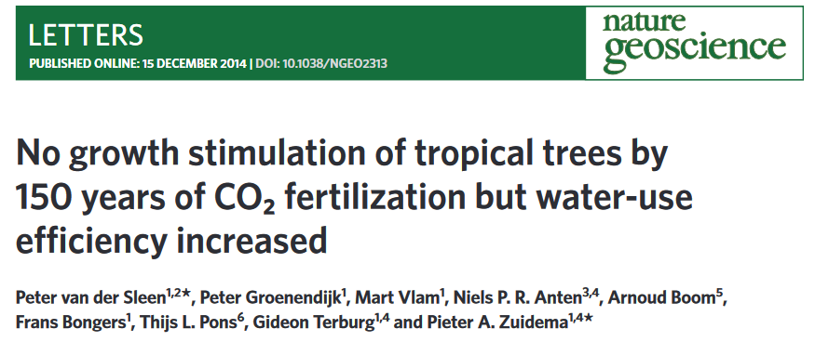
Conceptual Background

Slide 3
“A mixed-effect model revealed a highly significant and exponential increase of C_{i…} in both understory and canopy trees. C_{i} increased by 43% and 53% over the past 150 years for understory and canopy trees, respectively.
Yet, the rate of increase in C_{i} was consistently lower than that of atmospheric CO₂.”

Slide 4

“A mixed-effect model revealed a highly significant and exponential increase of C_{i…} in both understory and canopy trees. C_{i} increased by 43% and 53% over the past 150 years for understory and canopy trees, respectively.
Yet, the rate of increase in C_{i} was consistently lower than that of atmospheric CO₂.”

Slide 5

$$g_{s}= \left(1+ \frac{g_{1}}{\sqrt{D}}\right)\frac{A}{C_{a}}$$
D is vapour pressure deficit (kPa), A is net photosynthesis rate
(μmol m−2 s−1), Ca is CO2 concentration at the leaf surface (ppm), and g1 is the
model coefficient

Slide 6

Experimental Design
x100

Slide 7
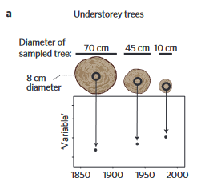
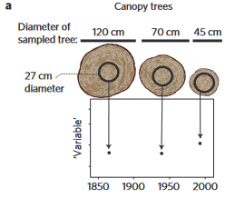
Experimental Design

Slide 8

Canopy Trees
Each individual tree is then considered twice. Once at the year when it is an ‘understory tree’ and once at the year when it is a ‘canopy tree’ as determined by DBH.
Understory Trees

Slide 9



Canopy Trees
Chukrasia tabularis
Toona ciliata
Afzelia Xylocarpa
Melia azedarach
Each individual tree is then considered twice. Once at the year when it is an ‘understory tree’ and once at the year when it is a ‘canopy tree’ as determined by DBH.
Understory Trees

Slide 10
Data Collected/ Available
Canopy Trees
Afzelia Xylocarpa
Monthly Temperature Data
Monthly Rainfall Data
Time-Tagged Ci (Intracellular Carbon)
Time-tagged Atmospheric Carbon
Growth Data
The VDS paper used carbon isotope samples from the 8cm and 27 cm tree ring samples to determine Ci from the existing record of atmospheric CO₂

Slide 11
We are currently using models to predict the response of tropical forests to carbon fertilization.
Currently, models overpredict growth that is not happening in-field.
This assumption is based on the belief that carbon fertilization should stimulate photosynthesis and thus growth.
In the absence of a growth response, we need to examine our assumption/beliefs.

Slide 12

This is particularly important as dynamic global vegetation models (DVGMs) predict that increased growth in tropical forests will be a buffering effect for carbon fertilization.
If forests are not growing as predicted, they cannot act as carbon sinks. This would result in an overestimation of the carbon sequestered in tropical forests.
Bad for our future budgeting, essentially.

Slide 13
So… What to do.
Explore the sensitivity of Ci to several variables:
Categorical Variables
Tree Species
Tree Size/Age Class
Continuous/Quantitative Variables
Temperature
Precipitation
Seasonal Variation
Data Exploration & Prognostic Modeling

Slide 14

Deriving Significant Climate Variables
We are interested in the response of Ci – derived from isotope data. To disentangle that response from the last 100 years of carbon fertilization, I looked specifically at the Ci/Ca ratio.

Slide 15
Deriving Significant Climate Variables
In our case, intracellular carbon (Ci) is increasing at a slower rate than ambient concentrations (Ca).
In other word, this ratio is not constant over time.
This indicates a change in photosynthesis or stomatal conductance.
a and b here represent fractionation factors associated with rate of diffusion of Co2 across the plant membrane (a) and photosynthesis (carboxylation) (b)

Slide 16


Deriving Significant Climate Variables
Ultimately leaf-to-air VPD (vapor pressure deficit) determines photosynthesis and stomatal conductance.
VPD itself is a product of temperature and humidity.

Slide 17
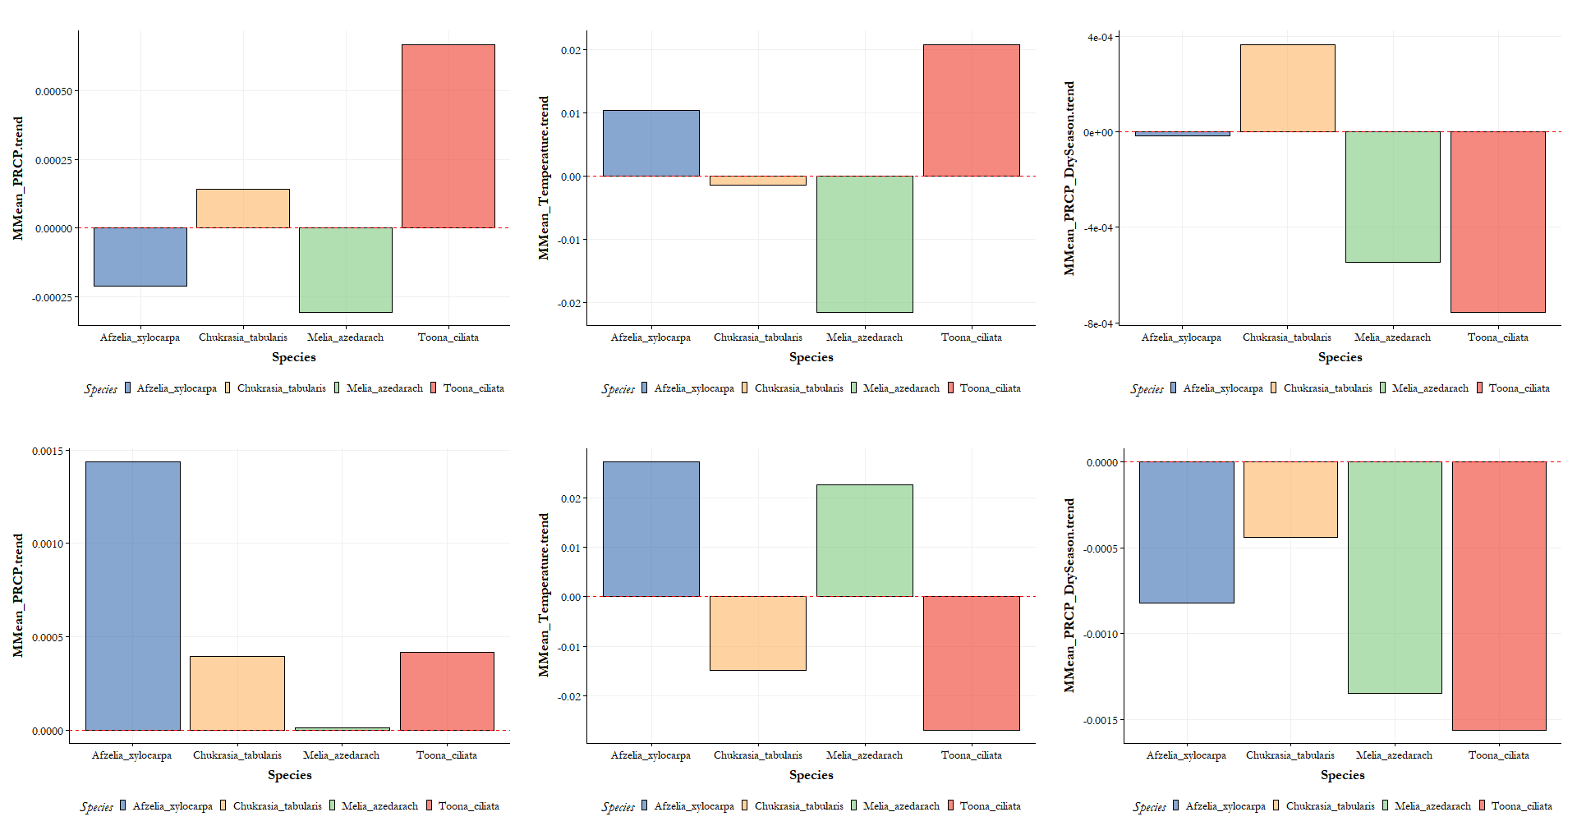
p.value key: ** = <0.05 * = <0.025 . = <0.1
*
.
CANOPY
*
**
.
.
UNDERSTORY
*

Slide 18
*
.
CANOPY
***
*
**
.
.
UNDERSTORY
***
*

